Slide 1




PSHE

Slide 2
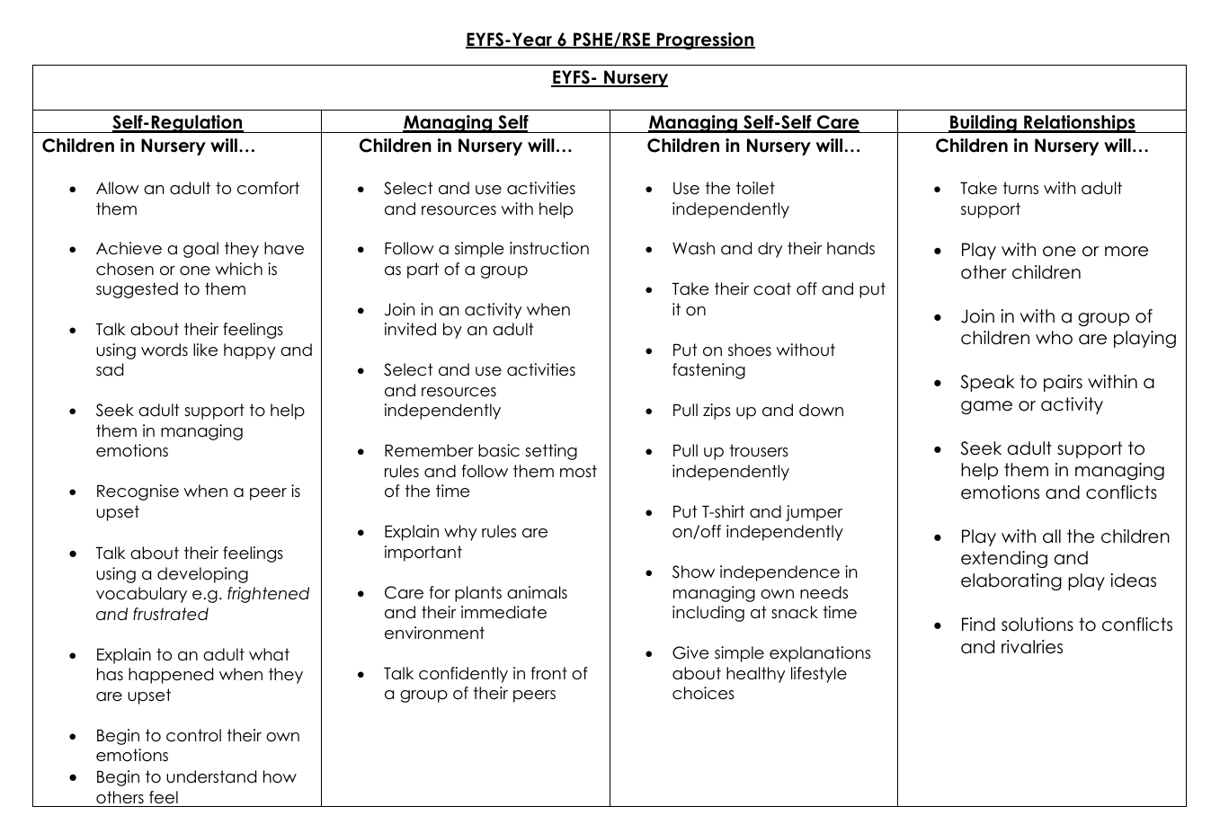
PSHE Overview

Slide 3
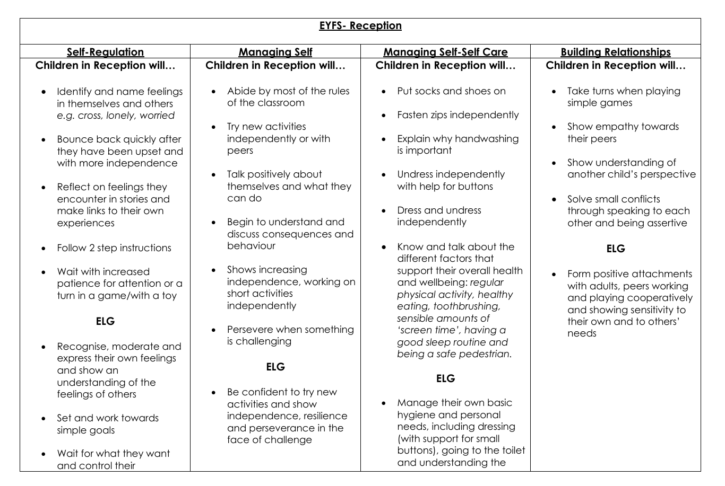
PSHE Overview

Slide 4
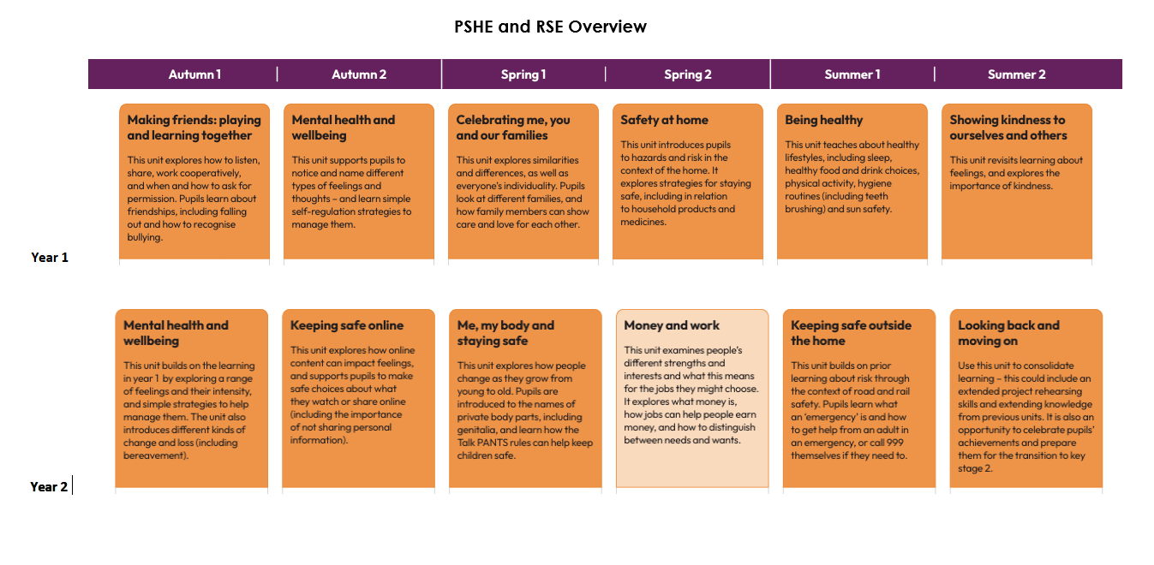
PSHE Overview

Slide 5

PSHE Overview

Slide 6
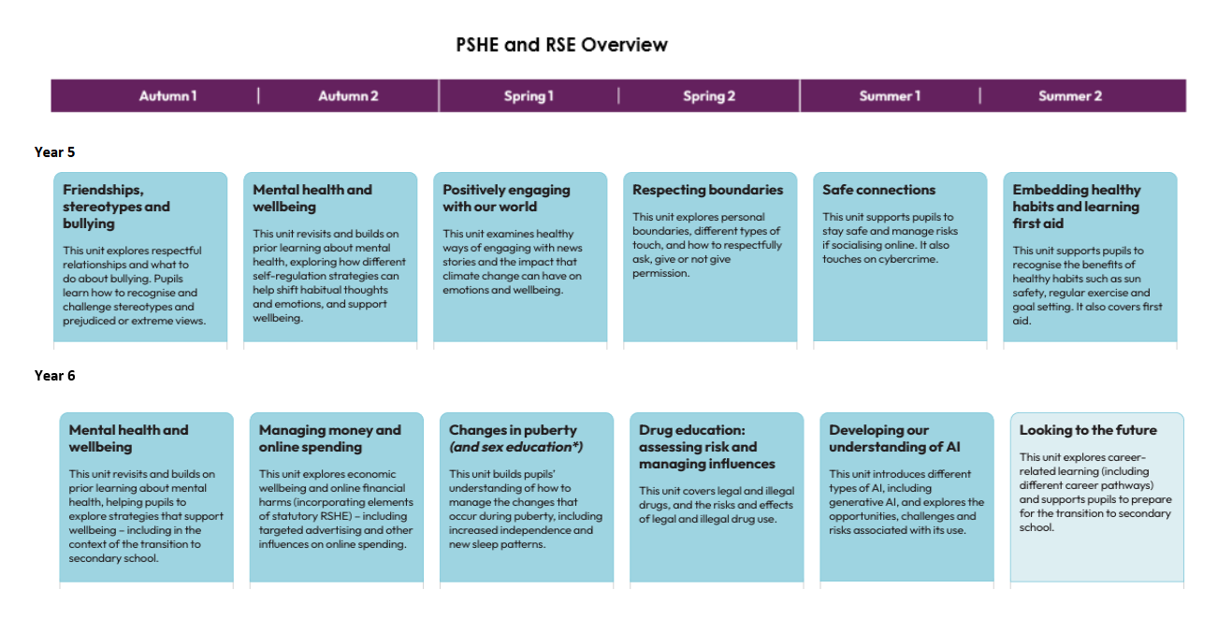
PSHE Overview

